Slide 1
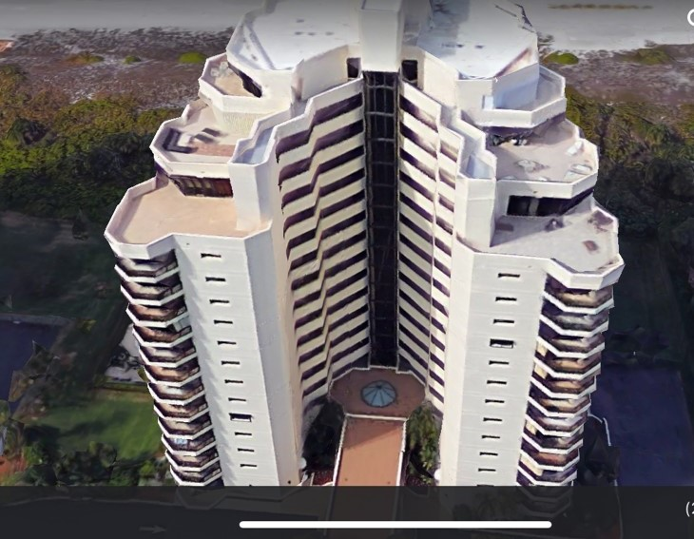
Sandcastle II 2024 Season

Slide 2
New Lobby Roof Dome

Slide 3
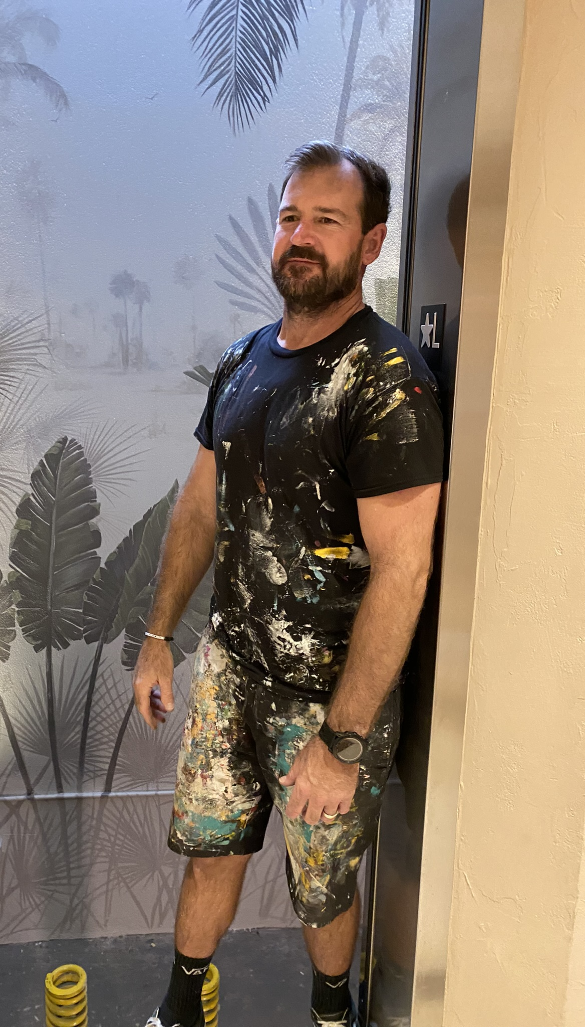
Glass Elevator Enclosure
Glass Elevator Mural

Slide 4
Activities

Slide 5
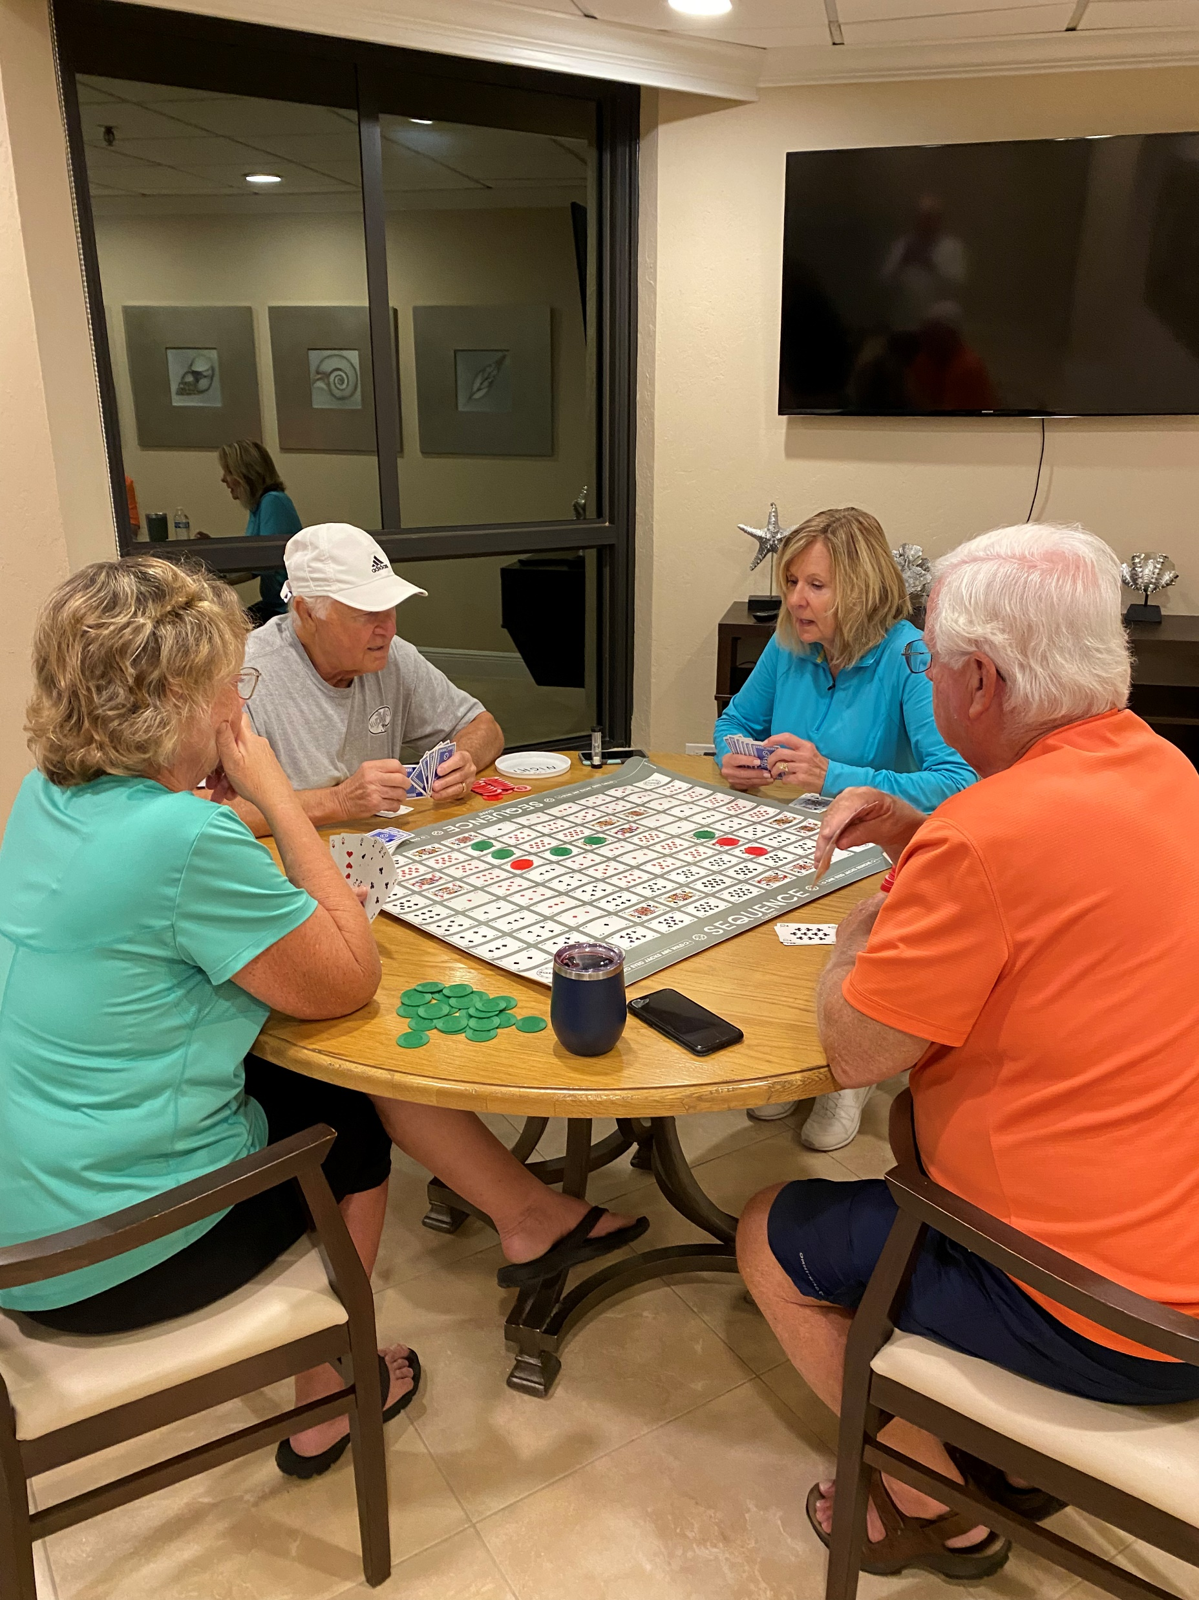
Game night

Slide 6
Bingo

Slide 8
Canasta

Slide 9
Superbowl

Slide 10
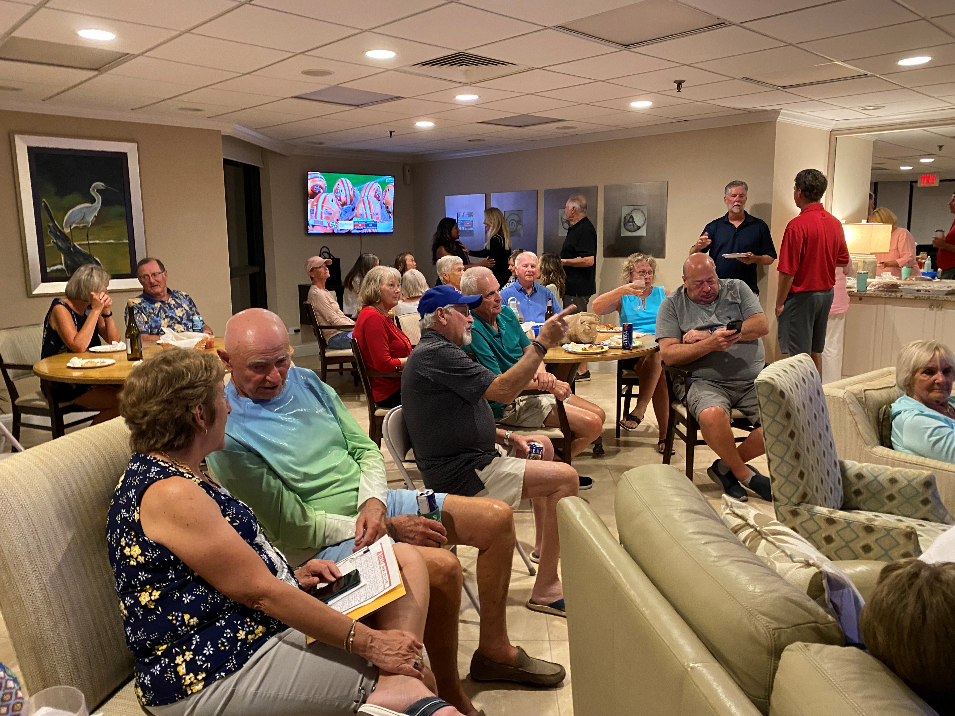

Slide 11
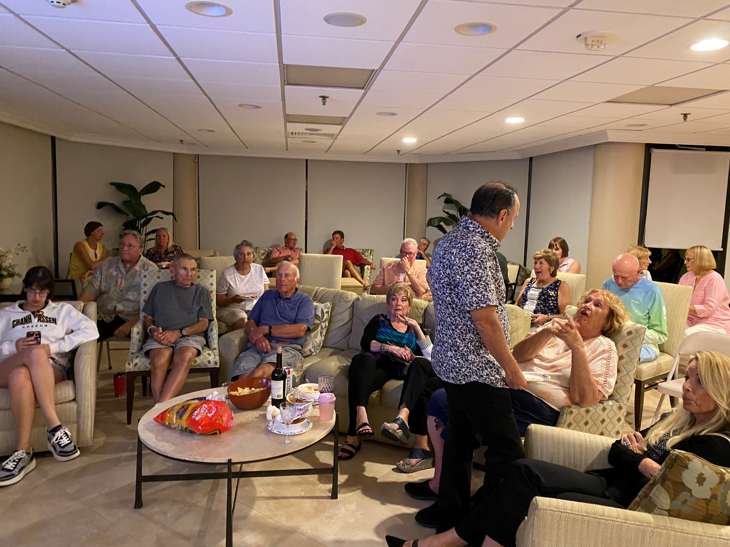

Slide 13
Pickleball

Slide 15
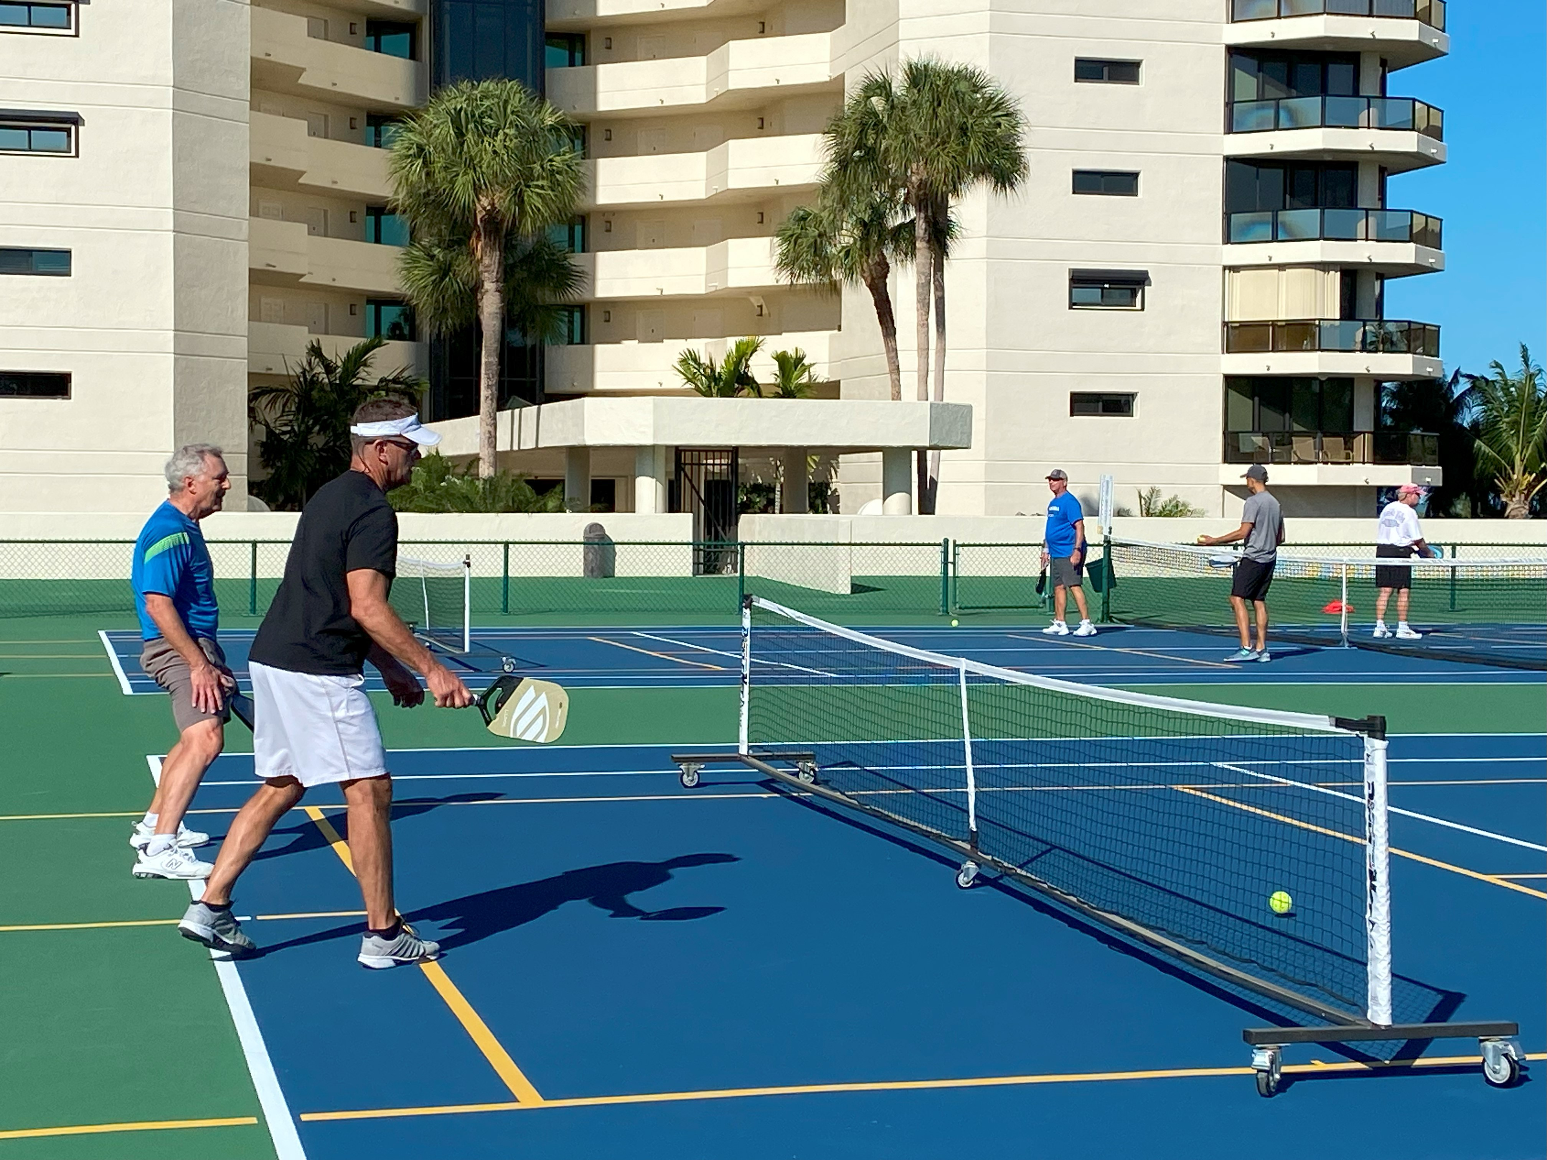

Slide 16
Duck Races

Slide 21
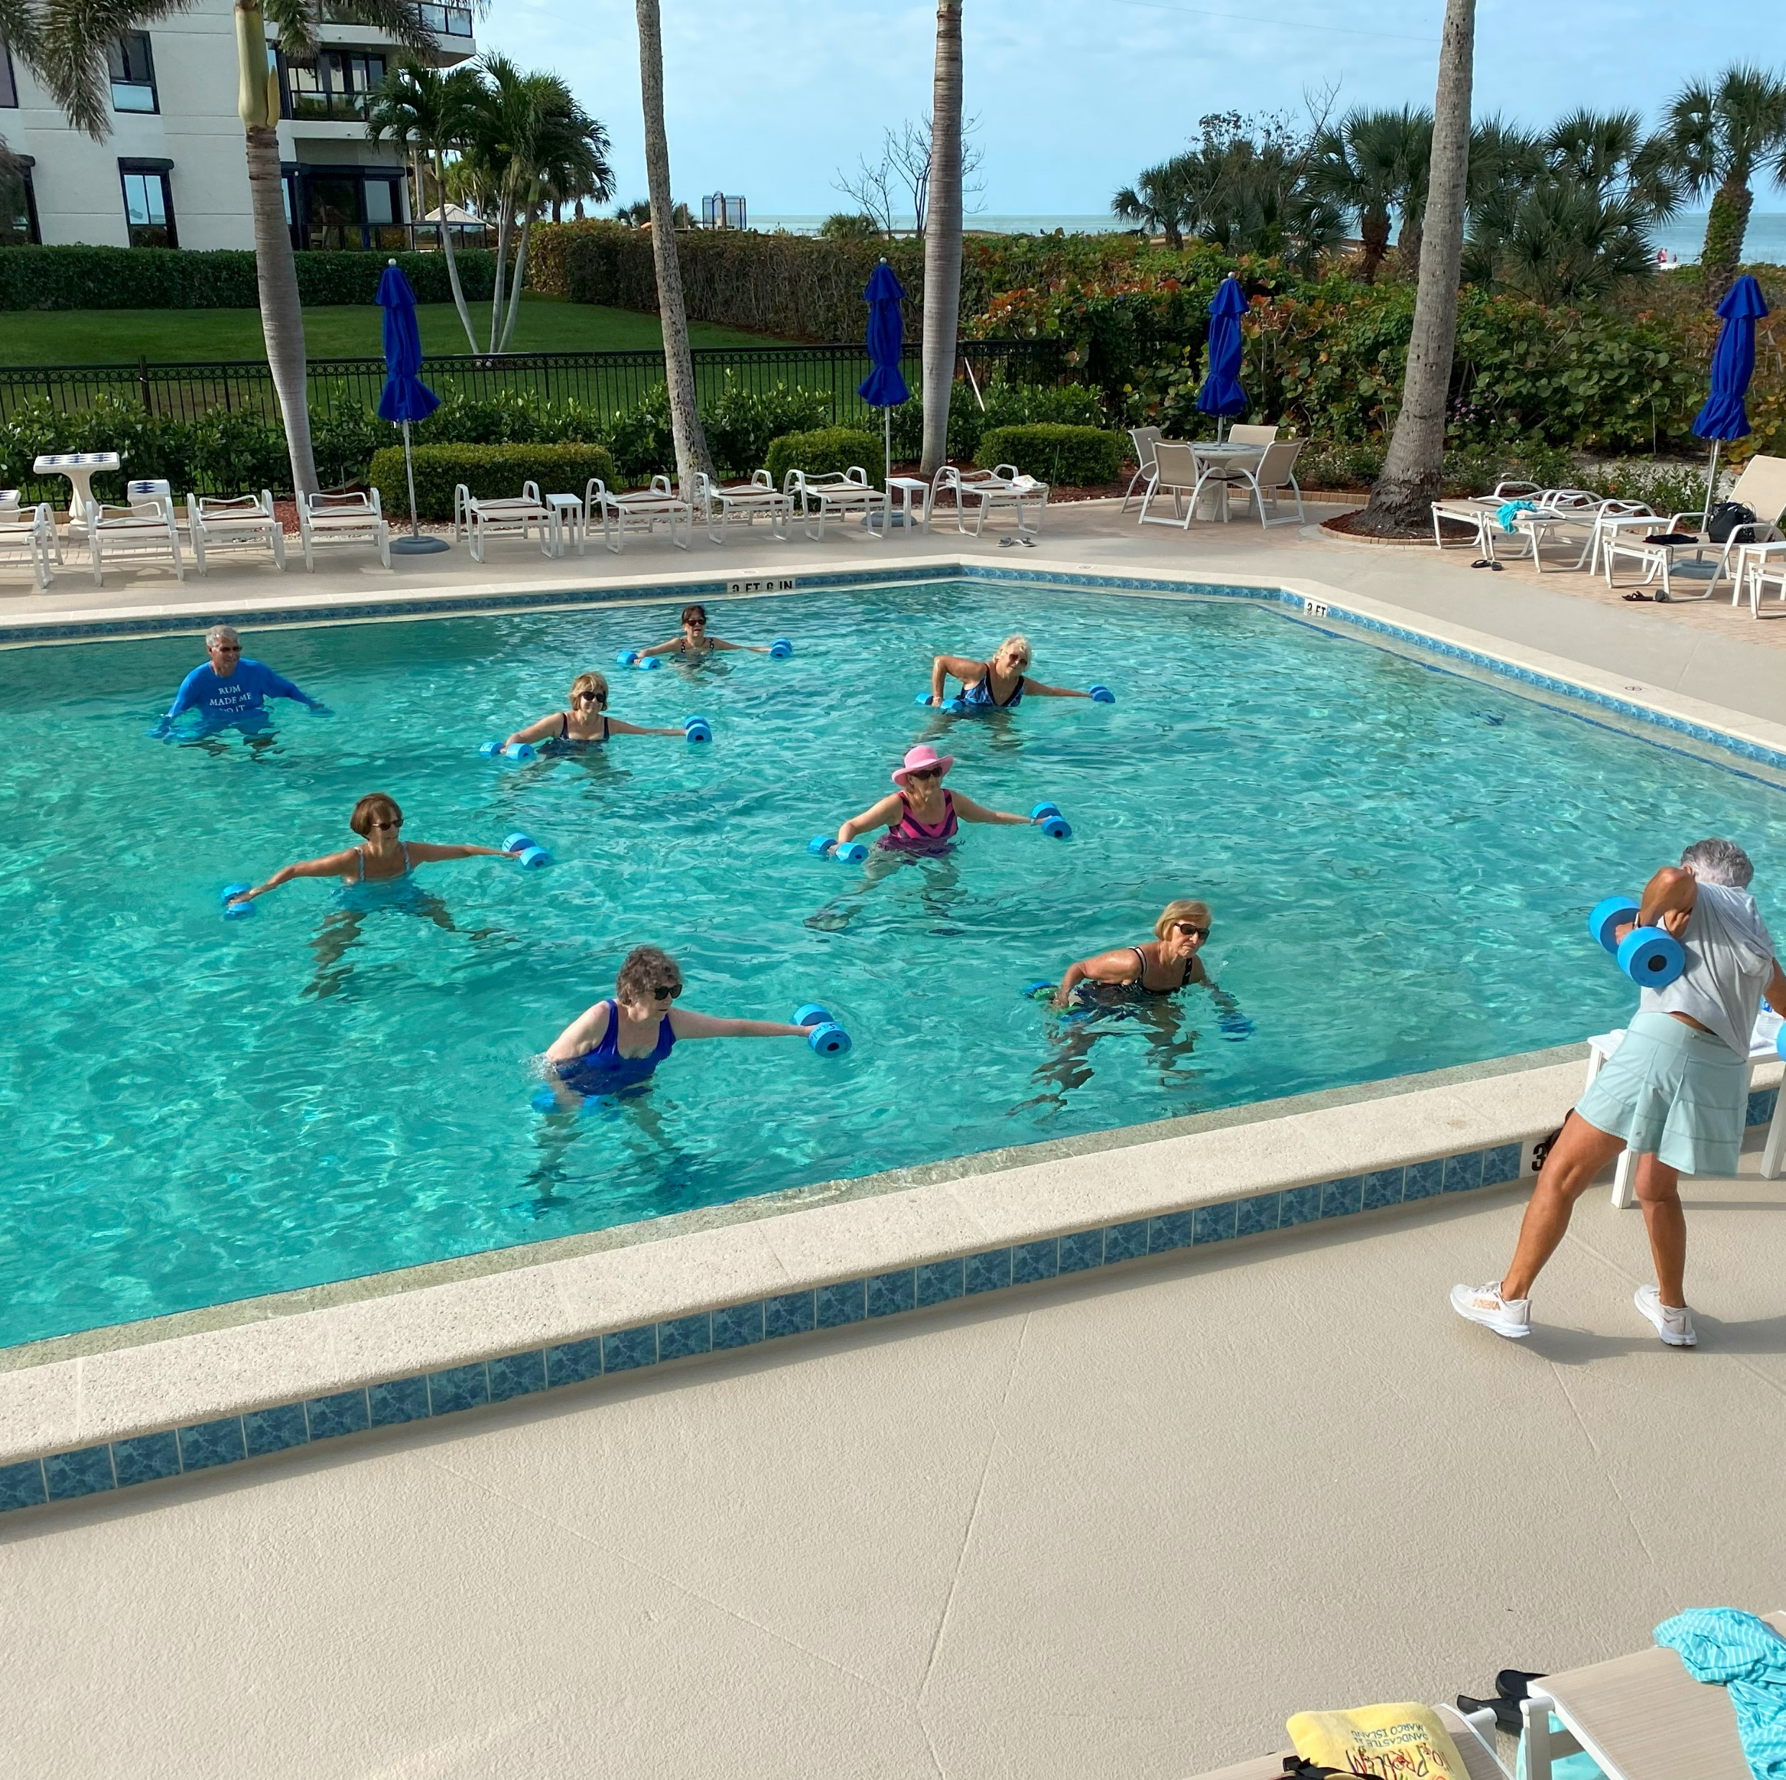
Water Aerobics
Wednesday morning with Toni

Slide 22
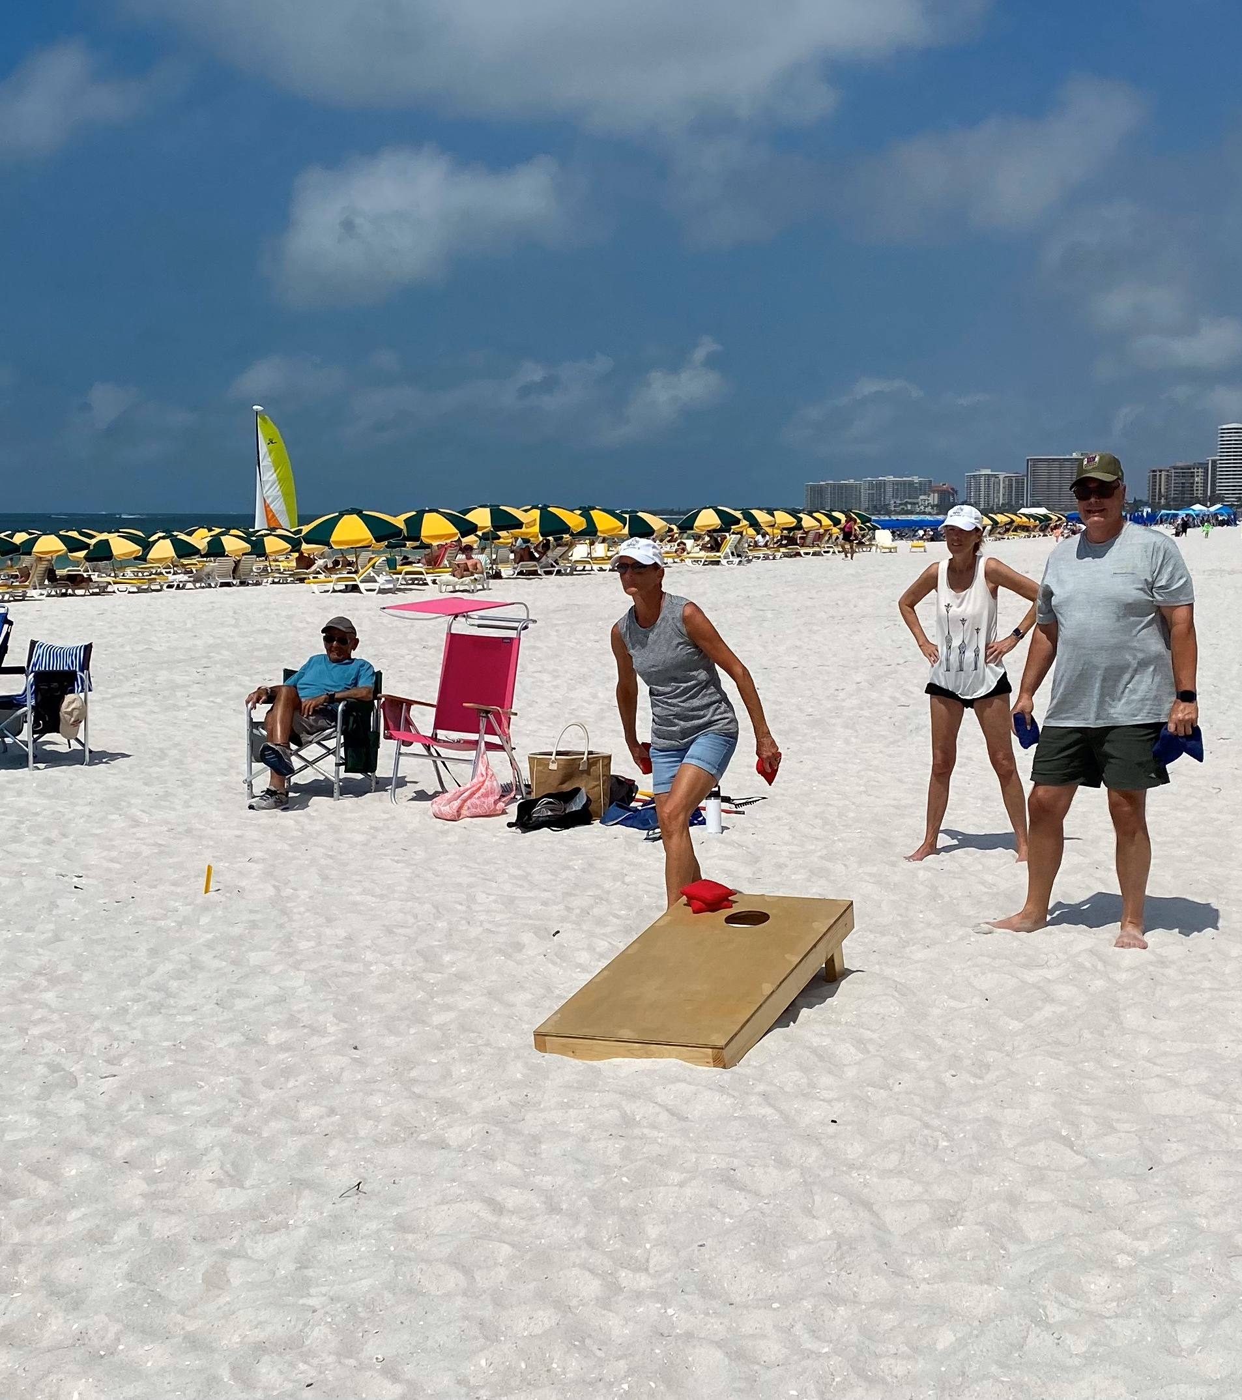
Sunday Bocce and cornhole

Slide 23
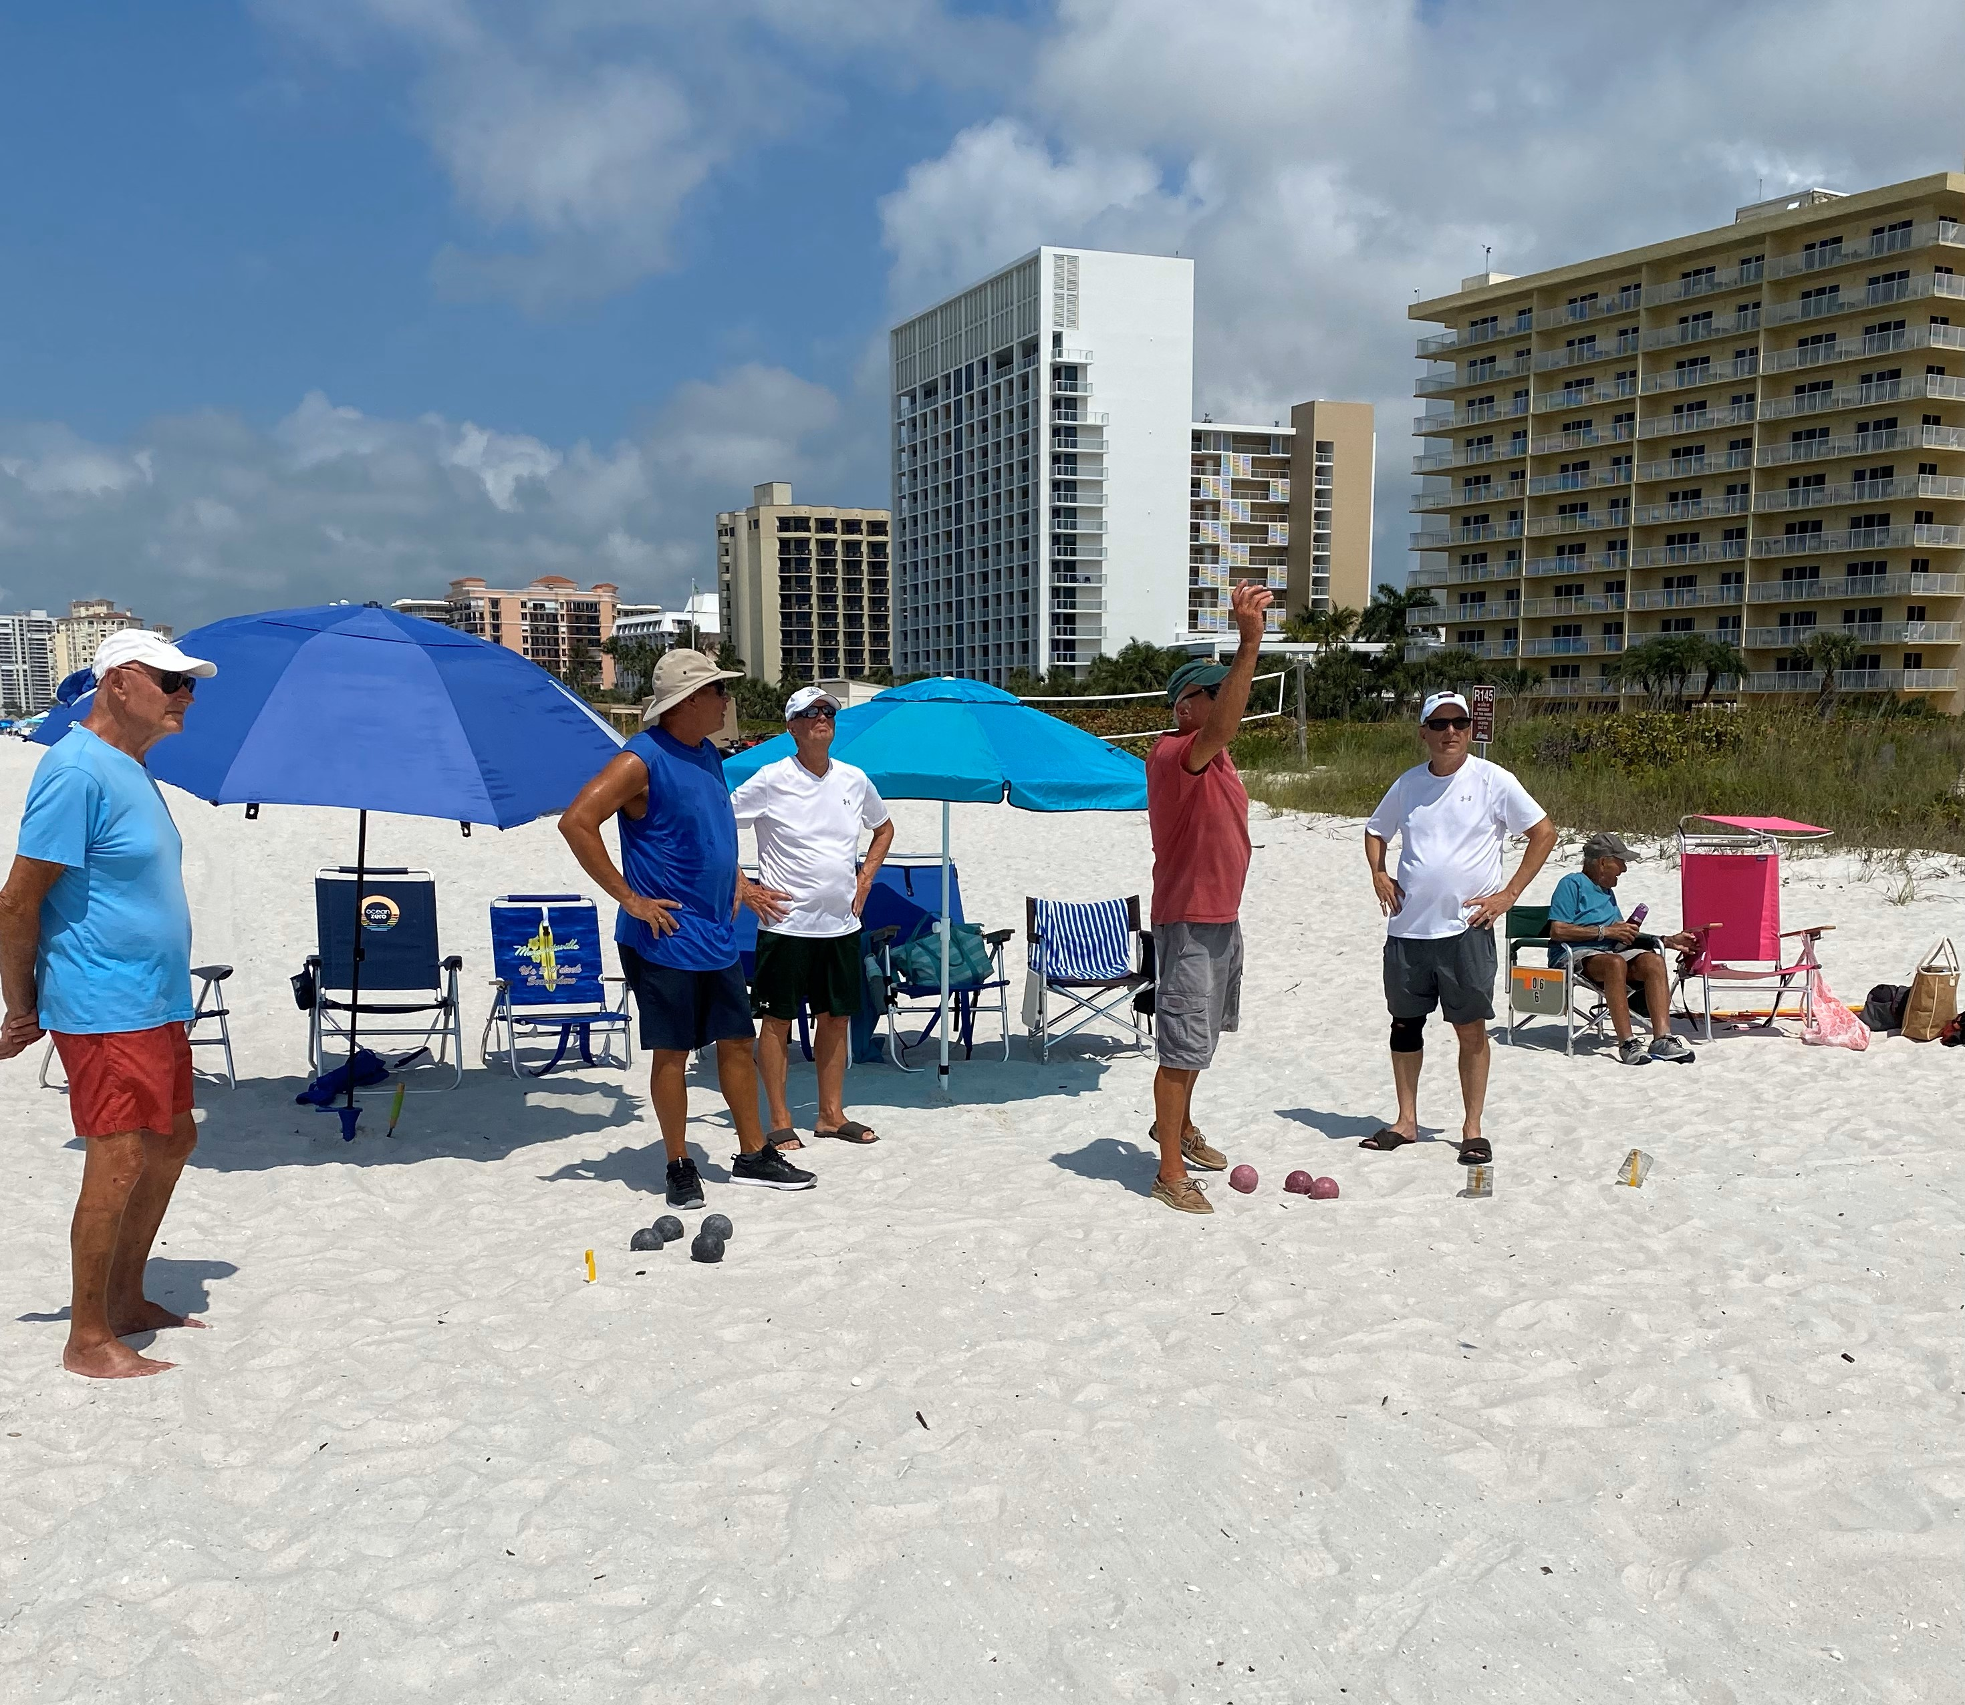

Slide 24
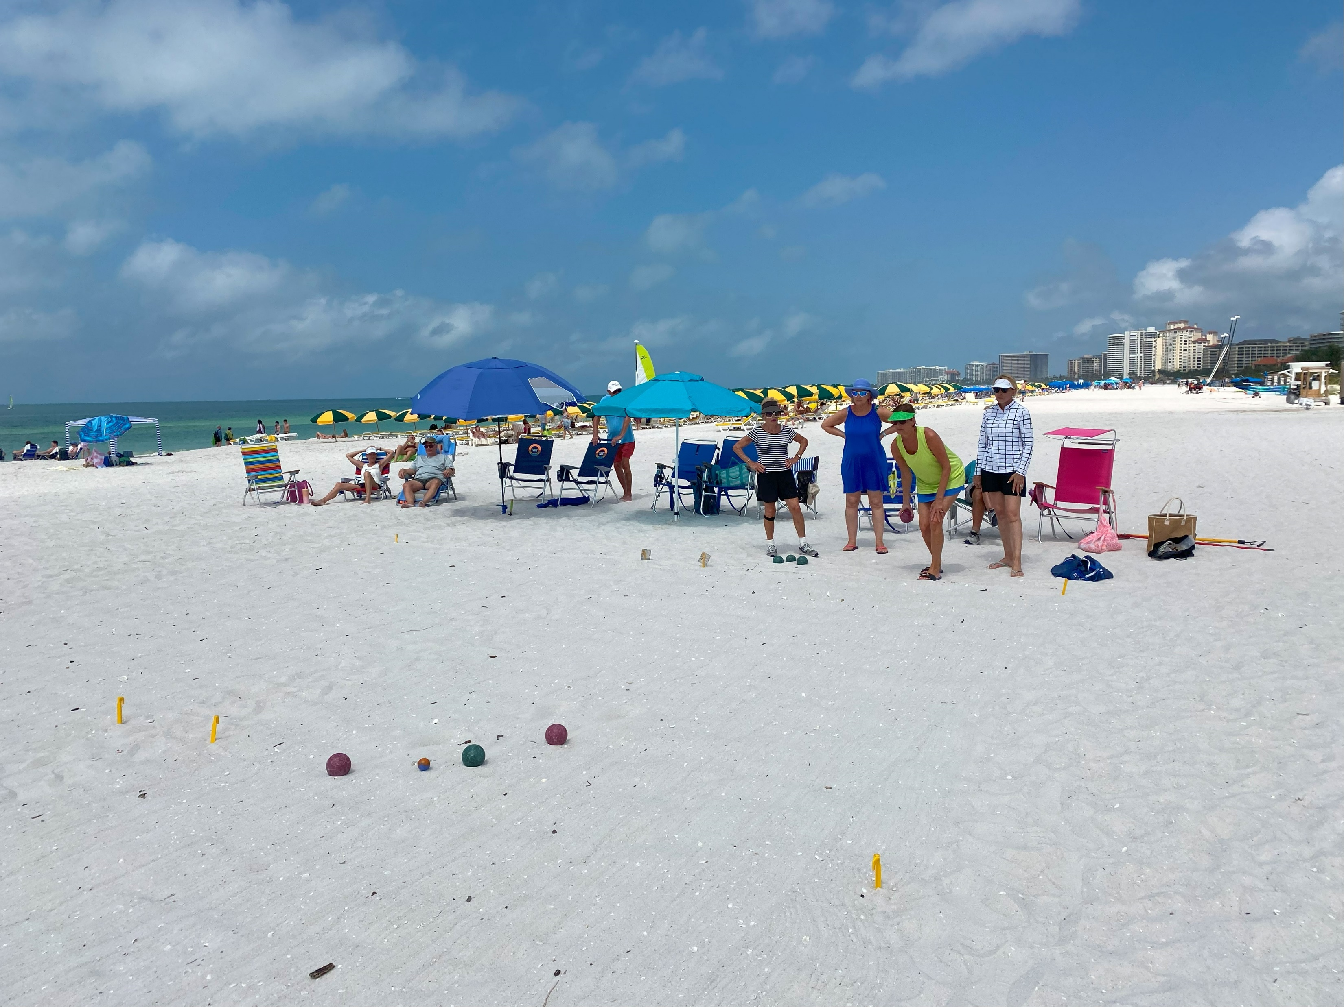

Slide 25
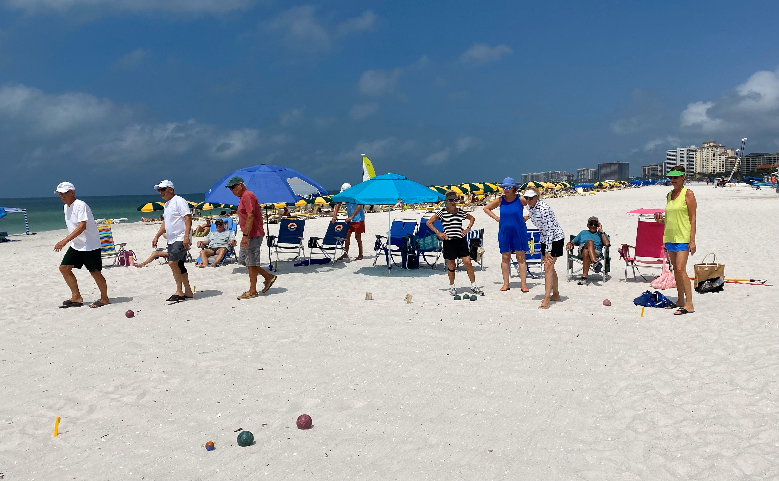

Slide 26
Closing Dinner

Slide 31
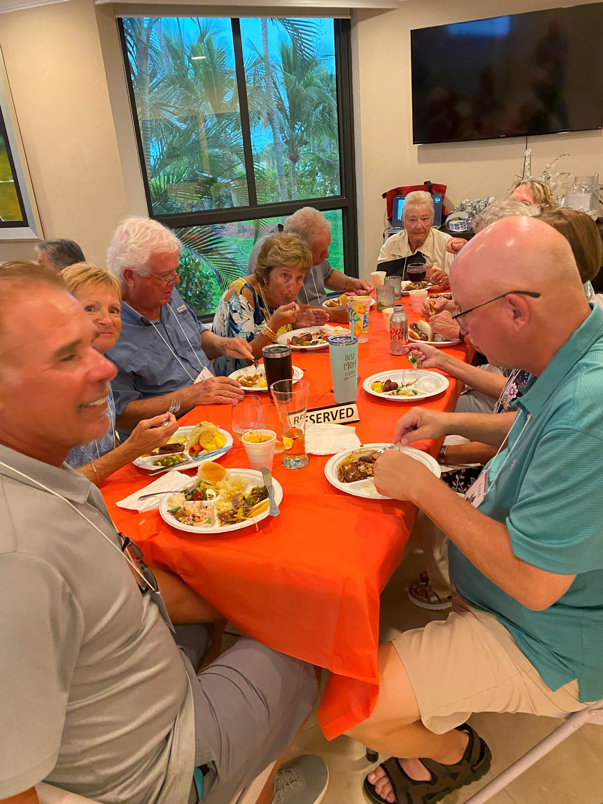

Slide 33
See You Back Next season

